Slide 1
Programming Languages

Slide 2
Algorithms
An algorithm is a step-by-step method for solving a problem.
An algorithm should have following characteristics:
Each instruction should be precise and unambiguous.
Each instruction should execute in finite time.
After the termination of the algorithm, the desired result should be obtained.
Example: Finding highest marks in a class.
Input the number of students N.
Initialize the number of mark sheets checked and highest marks to 0.
Read the next mark sheet . If the marks of the student is greater than
highest marks, highest marks = marks of the student just checked.
Add 1 to the number of mark sheets checked.
Repeat steps 3 and 4 till the no. of mark sheets checked is N.
Print highest marks.

Slide 3
Programming Languages
A programming language is a language of computer; a programmer uses a programming language to instruct the computer what is to be done.
Like every language, there are a certain rules to produce valid sentences for a programming language, called syntax rules.
Programming languages can be classified broadly into three categories:
Machine languages,
Assembly languages,
High level languages.
Low level languages

Slide 4
Machine Language:
Written as a string of 0s and 1s.
The computer recognizes it immediately.
It converts the corresponding instructions to electrical signals needed to execute them.
A machine language is difficult to read and understand.
It is machine dependent.
Assembly Language:
Uses alpha-numeric codes for the instructions, such as ADD, SUB, MUL etc. Memory locations may be referred as FRST, SCND etc.
Additional instructions can be provided in the instruction set, like START PROGRAM AT 000, START DATA AT 1000, etc.
An assembly language program is converted into machine language by a translator, called assembler.

Slide 5
Assembly language is easier to understand than machine language.
Assembly language is machine dependent. The assembler translates instructions of the assembly language program into machine language instructions for a particular type of machine.
Assembly lang. program
Machine lang. program
Assembler
(source program)
(object program)

Slide 6
Given below are some simple instructions for an assembly language program:
ADD R1 R3 R5 1001 001 011 101
SUB R2 R6 R1 1010 010 110 001
Meaning :
1. Add R3 to R5 and put the result in R1.
2. Subtract R1 from R6 and put the result in R2.
Instruction
Machine code
Operation
Result
Operand 1
Operand 2

Slide 7
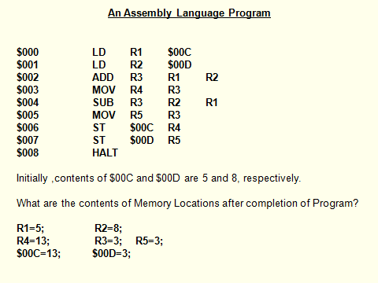

Slide 8
High Level Languages:
Both machine languages and assembly languages are machine dependent. It is difficult, time consuming and error prone to write programs in these languages.
High level programming languages overcome these limitations.
They have following properties:
They are machine independent.
Programmer is not required to know about the internal structure of the computer.
They do not deal with the machine level coding. Instructions are written in English words and familiar mathematical symbols and expressions.

Slide 9
Compiler:
A compiler is a translator program that translates a high level language program into its equivalent machine language program.
It compiles a set of machine language instructions for every program instruction of a high level language.
A compiler does one-to-many translation; it produces different object codes of a high level language for different types of machines.
A compiler only translates a high level language program into the equivalent object code, it does not execute the program.
High level lang. program
Machine lang. program
Compiler
(source program)
(object program)

Slide 10
A compiler translates only source programs written in the language which the compiler can translate. A separate compiler is required for each high level language.
Also, an object code for one computer may not be the same as the object code for another computer.
Compilers are large programs that are stored permanently on secondary storage.
To translate a source program, a computer first loads the compiler and the source program from the secondary storage into the main memory. The computer then executes the compiler (which is itself a program) with source program as input data.
Compiler then generates the object code as output, which is saved in a separate file.

Slide 11
Compiler for L on computer A
Machine code for L that will run on A
Executed on A
Program P
In high level language L
Same result
Compiler for L on computer B
Machine code for L that will run on B
Executed on B
One-to-many translation by a compiler

